Slide 1
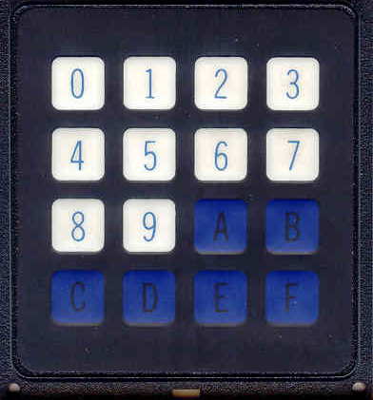
CSE360-Computer Interfacing BRAC University Keyboard Interfacing with MPU through 8255 PPI
0

Slide 2
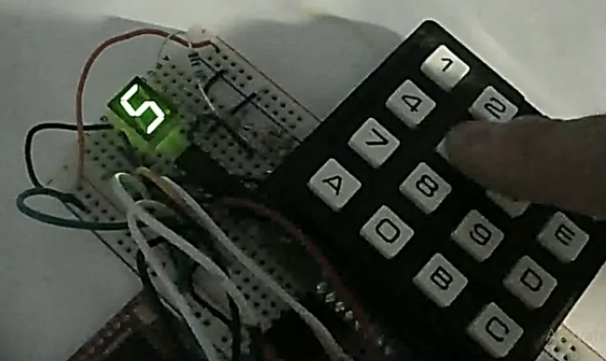
Hex Keyboard and 7-segment display
Content Credit: OPENBOX Education

Slide 3
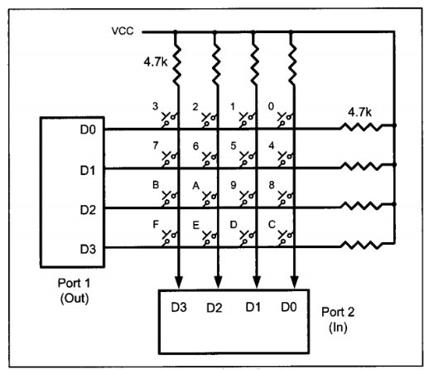
Hex Keyboard Interfacing
0
0
0
0
1
1
1
1

Slide 4
Defining Control Register and Ports of 8255
We know there are four rows Suppose, R0 DB 0 1 2 3
R1 DB 4 5 6 7
R2 DB 8 9 0A 0B
R3 DB 0C 0D 0E 0F
KEYPRESSED DB 0
8255 control word send to control register
MOV AL, 82H
OUT CWR, AL
Control Word Register (CWR)
8 |  |  |  | 2
1 | 0 | 0 | 0 | 0 | 0 | 1 | 0
I/0 | MODE 0 PORT A |  | PORT A Output |  | MODE 0 PORT B | PORT B Input
Content Credit: OPENBOX Education

Slide 5
Column Identification
C3 | C2 | C1 | C0
1 | 1 | 1 | 1
Rows are grounded
MOV AL, 0 OUT PA, AL IN AL, PB CMP AL, 0FH JZ KEYPRESS CALL DELAY
3 | 2 | 1 | 0
7 | 6 | 5 | 4
B | A | 9 | 8
F | E | D | C
R0 | PA0 | 0
R1 | PA1 | 0
R2 | PA2 | 0
R3 | PA3 | 0
Columns are connected to VCC
1 | 1 | 1 | 1
PB3 | PB2 | PB1 | PB0
Content Credit: OPENBOX Education

Slide 6
Column Identification
C3 | C2 | C1 | C0
1 | 1 | 1 | 1
MOV AL, 0 OUT PA, AL IN AL, PB CMP AL, 0FH JZ KEYPRESS CALL DELAY
KEYPRESS:
3 | 2 | 1 | 0
7 | 6 | 5 | 4
B | A | 9 | 8
F | E | D | C
R0 | PA0 | 0
R1 | PA1 | 0
R2 | PA2 | 0
R3 | PA3 | 0
0FH = 1111
1 | 1 | 0 | 1
PB3 | PB2 | PB1 | PB0
Content Credit: OPENBOX Education

Slide 7
Row Identification – R0
C3 | C2 | C1 | C0
1 | 1 | 1 | 1
R0:
MOV AL, 1110 OUT PA, AL IN AL, PB CMP AL, 0FH JZ R1 LEA SI, R0 JMP COL
3 | 2 | 1 | 0
7 | 6 | 5 | 4
B | A | 9 | 8
F | E | D | C
R0 | PA0 | 0
R1 | PA1 | 1
R2 | PA2 | 1
R3 | PA3 | 1
1 | 1 | 1 | 1
PB3 | PB2 | PB1 | PB0
Content Credit: OPENBOX Education

Slide 8
Row Identification – R1
C3 | C2 | C1 | C0
1 | 1 | 1 | 1
R1:
MOV AL, 1101 OUT PA, AL IN AL, PB CMP AL, 0FH JZ R2 LEA SI, R1 JMP COL
3 | 2 | 1 | 0
7 | 6 | 5 | 4
B | A | 9 | 8
F | E | D | C
R0 | PA0 | 1
R1 | PA1 | 0
R2 | PA2 | 1
R3 | PA3 | 1
1 | 1 | 1 | 1
PB3 | PB2 | PB1 | PB0
Content Credit: OPENBOX Education

Slide 9
Row Identification – R2
C3 | C2 | C1 | C0
1 | 1 | 1 | 1
R2:
MOV AL, 1011 OUT PA, AL IN AL, PB CMP AL, 0FH JZ R3 LEA SI, R2 JMP COL
3 | 2 | 1 | 0
7 | 6 | 5 | 4
B | A | 9 | 8
F | E | D | C
R0 | PA0 | 1
R1 | PA1 | 1
R2 | PA2 | 0
R3 | PA3 | 1
1 | 1 | 0 | 1
PB3 | PB2 | PB1 | PB0
Content Credit: OPENBOX Education

Slide 10
Row Identification – R3
C3 | C2 | C1 | C0
1 | 1 | 1 | 1
R3:
MOV AL, 0111 OUT PA, AL IN AL, PB CMP AL, 0FH JZ R1 LEA SI, R3 JMP COL
3 | 2 | 1 | 0
7 | 6 | 5 | 4
B | A | 9 | 8
F | E | D | C
R0 | PA0 | 1
R1 | PA1 | 1
R2 | PA2 | 1
R3 | PA3 | 0
1 | 1 | 1 | 1
PB3 | PB2 | PB1 | PB0
Content Credit: OPENBOX Education

Slide 11
Key Press Identification
We got the value of column 1101 from Row 2 (R2)
Now we have to find the 0 by shift right (SHR) operation to find out the corresponding value and store that into KEYPRESS variable.
MOV AL, [SI] MOV KEYPRESSED, AL
1 | 1 | 0 | 1
R2 | 8 | 9 | 0A | 0B
[SI]
Content Credit: OPENBOX Education

Slide 12
.
Thank You For Your Attention

